Slide 1
Data Analytics in Practice
MS984 Case 2 – Group 4
Tarek Buisson – Piyatida Sriwimon – Liyi Tan – Conor Mooney Michael Patrick – Guy Neal – Salman Tahir

Slide 2
Introduction – current environment
Staff shortages, government
COVID pandemic
Current economic climate
=> Widespread delays in vital operations and cancer treatments, record high waiting times

Slide 3
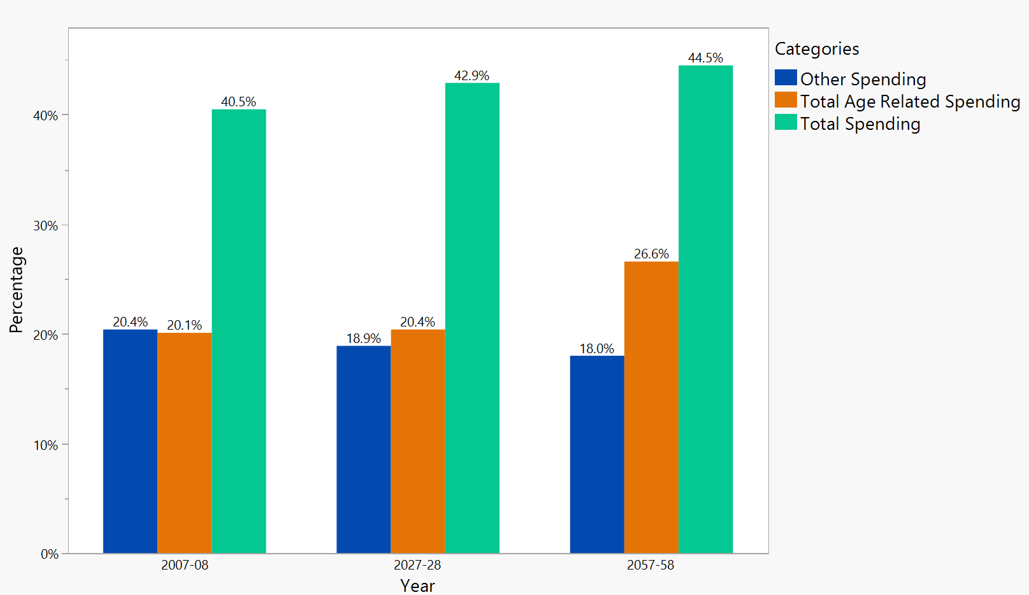
An aging population
Total Age-related Projected Spending

Slide 4
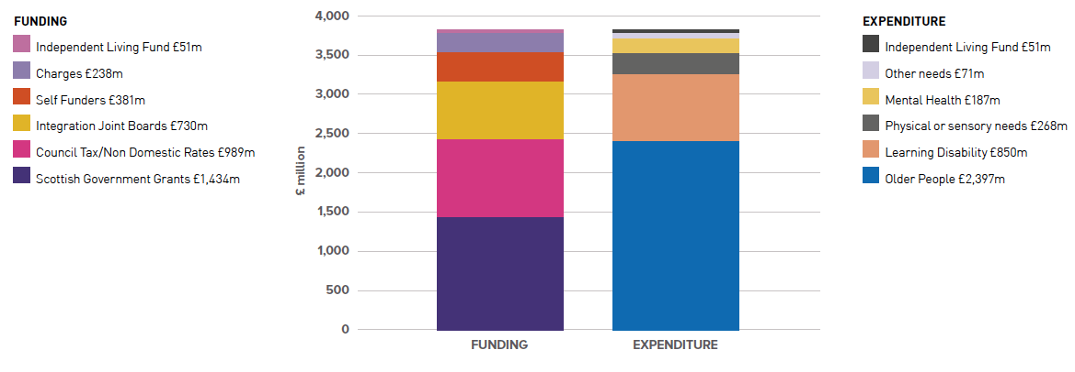
An aging population

Slide 5
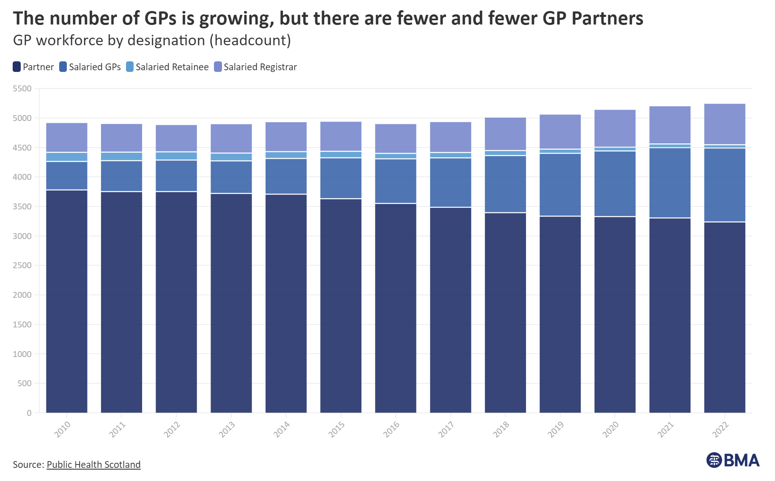
General Practitioners (GPs)

Slide 6
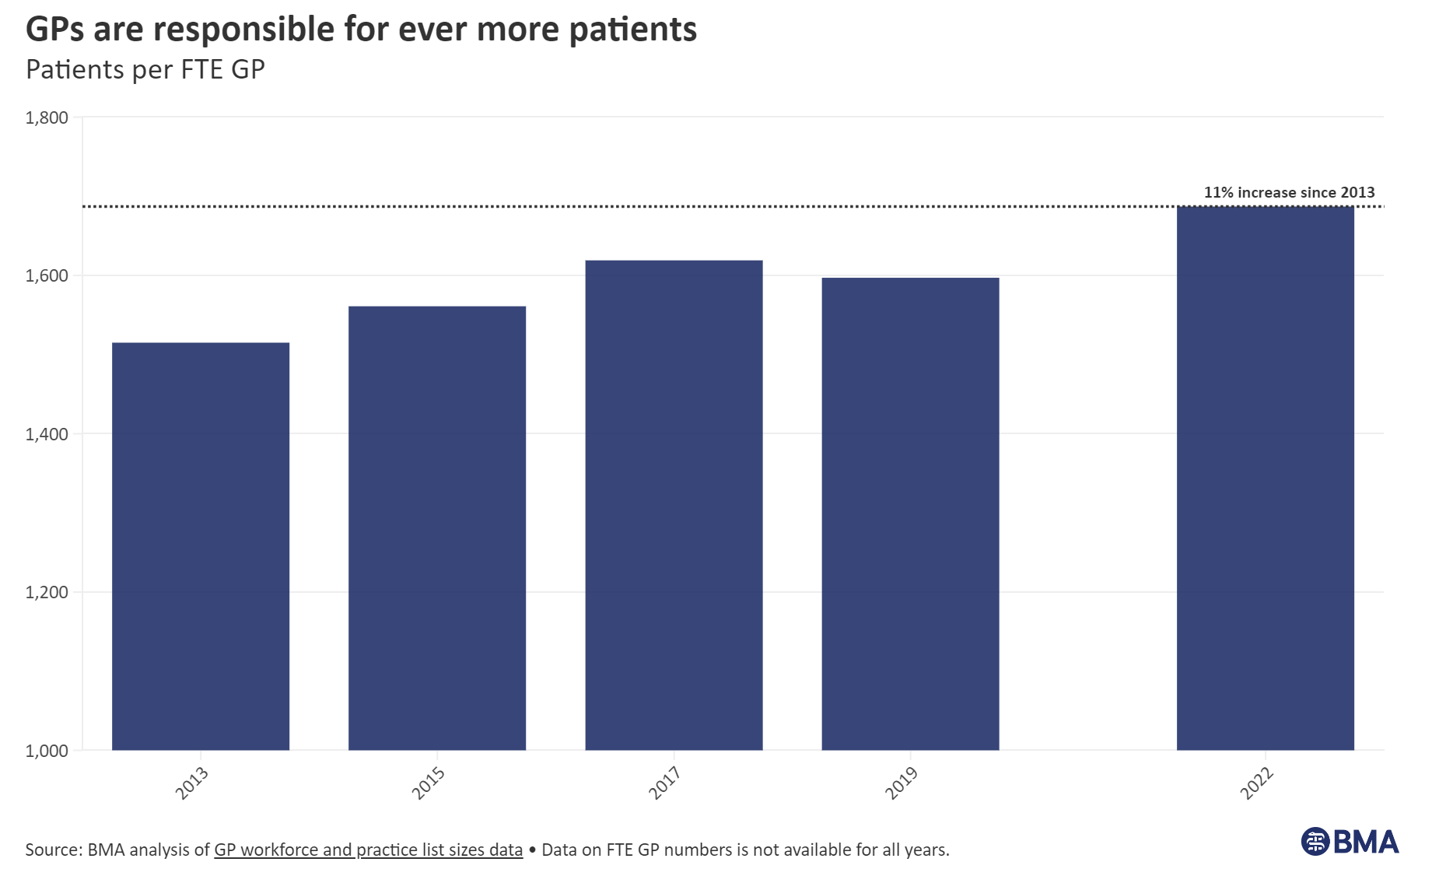
General Practitioners (GPs)

Slide 7
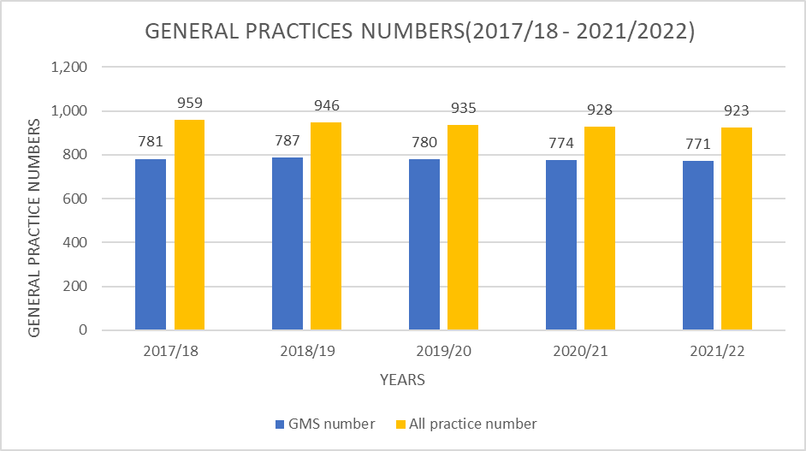
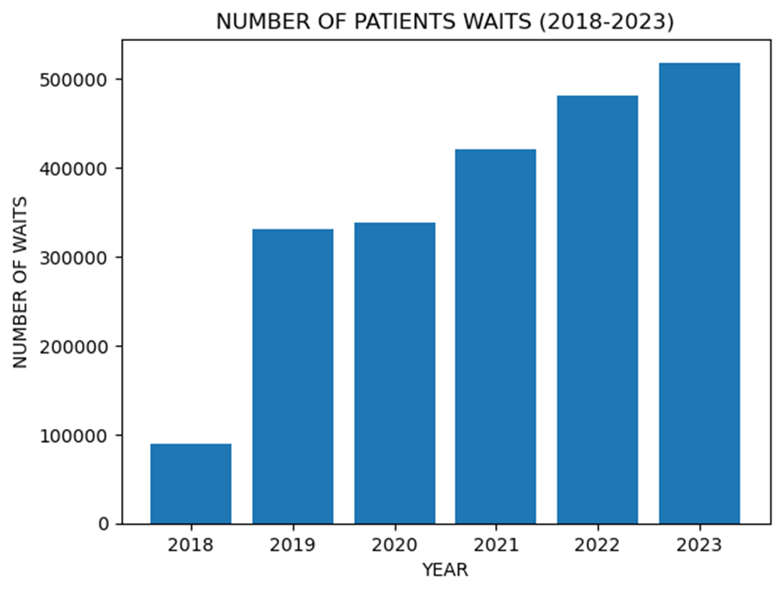
General Practitioners (GPs)

Slide 8
General Practitioners (GPs)
Surge in cancer cases due to lack of prevention (33% increase in diagnoses between 2008 & 2022)
Q4 2022: only 72% of eligible individuals received treatment, down from 84% in 2019 (target: 95%)

Slide 9
A promising solution
National Radiotherapy Plan for Scotland (2022)
Cyberknife treatment method, superior and cost-effective (free in Pakistan)

Slide 10
Electronic health records
Include a patient’s’ medical history, notes and data
Freely accessible to other health professionals
Success in other countries (Denmark, Israel)

Slide 11
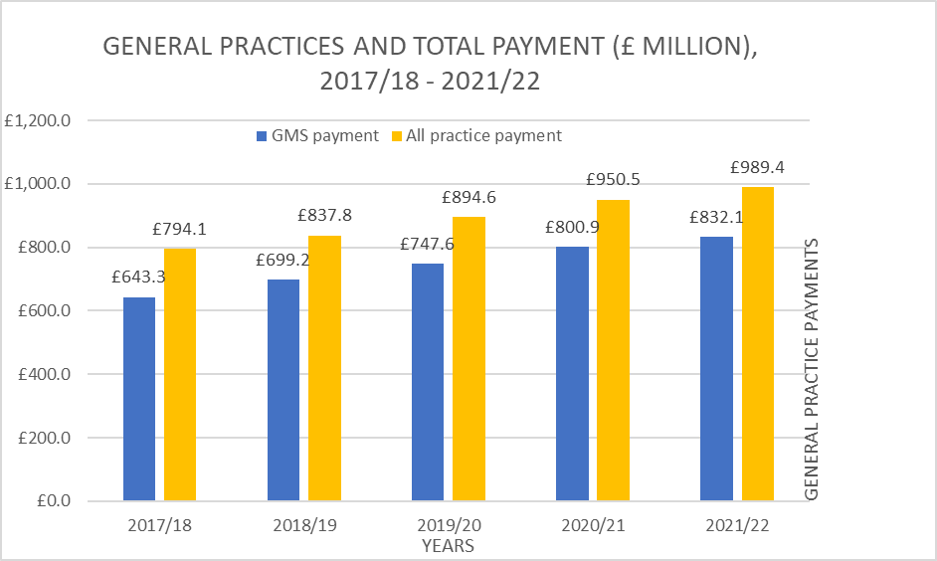
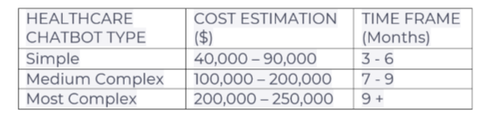
Using AI Chatbot in Healthcare
In order to take a load off doctors, initial contact

Slide 12
Big Data Analytics
The adoption of cloud solutions can enable utilisation of health data more effectively.
Cloud platforms can support the utilisation of AI in healthcare and medical research.
Cloud organisations (AWS, Microsoft, Google) have implemented high levels of security.
Healthcare cloud computing market forecasted to grow at a CAGR of 17.8% from $39.4billion to $$89.4billion.

Slide 13
Conclusion
Alleviate the strain on healthcare with cost-effective technologies
National Radiotherapy Plan for Scotland (Cyberknife)
AI-powered chatbots
Electronic Health Records (EHR)
Cloud solutions and integration of big data analytics

